Slide 1
Alarm Notifications from Geo SCADA
Demonstration code
Provided by Schneider Electric
Notify and Redirector source sample code not supported, please see Geo SCADA Support Forum to discuss

Slide 2
What the demonstration can do?
Send SMS and Voice alarm notifications from Geo SCADA
It uses the Twilio cloud service to manage notifications
Other services could be easily added
An inexpensive subscription is required with Twilio
Any text can be sent via voice or SMS messaging
Notification of success or failure, and alarm acknowledgements are possible
Notes:
Use of this demonstration will require you to build the code for your release of Geo SCADA. (It may be built for earlier ClearSCADA versions, but not take advantage of the new alarm redirection method to user’s phone numbers).
You also need to deploy the Driver and Redirector securely, making any code changes you need for your application’s security and reliability.
You can customise the application for your language and choice of services.

Slide 3
Architecture
This driver can be installed on main/standby architectures
This server can be in a DMZ or the cloud
Cloud subscription
Outgoing requests & responses
Geo SCADA Server
“Notify” driver
“Redirector” web server/client
Requests to start flow
Twilio service
Alarm Flow
Status updates
Example code
Web Client
Web Client &
Web Server (http/s, configurable port)
Web Client &
Web Server (https)

Slide 4
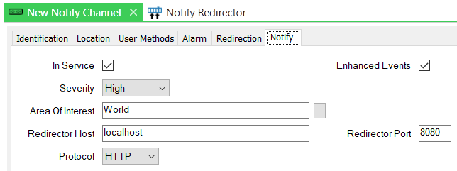
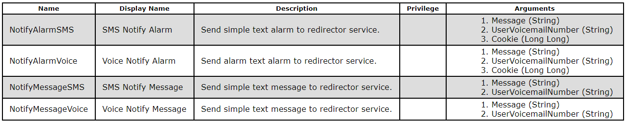
How it works – the Driver
The Notify Driver is written in C#
It has two objects
A ‘channel’ to set the parameters for communicating with the Redirector
A Redirector ‘scanner’ to set some parameters for the Twilio service
(You could extend this to add further services as ‘scanners’)
The Driver presents database Methods on the Scanner object
These accept parameters and send requests to the Redirector
They can be referenced by the new Alarm Redirection object
Requests are sent as http or https messages, outgoing only
Message URL is fixed, so can be easily restricted by a firewall

Slide 5
How it works – the Redirector
The Redirector is a .exe file which sets up a simple web server to receive requests from the Driver
The Redirector makes requests to the Twilio service using the parameters passed from the Driver
The Redirector also receives web service requests from Twilio with details such as message success/failure and alarm acknowledgement requests from users
These are passed back in polls made by the Driver to the Redirector
While data back to Geo SCADA is delayed somewhat, this is much more secure than providing an open port on the Driver

Slide 6
Driver to Redirector
Web client
Web server
“Notify” driver
“Redirector” web server/client
Web service hosted on /NotifyRequest/
Data sent in query string parameters
If type is ‘SMS’ or ‘VOICE’ this is a request to make a call or message
key is the Twilio service key, phone message and cookie are used to make the call
If type is ‘STATUS’ this is used to request feedback from Twilio, such as call failure – the responses are buffered (see next page) and fed back as lines in the response body
If type is ‘STATUS’ and alarm acknowledgements are set up in Twilio, and the #define feature ‘FEATURE_ALARM_ACK’ is enabled then the request message sends alarm acknowledgement status messages to the Redirector

Slide 7
Redirector to Twilio
Web client & Server
Web server & Client
“Redirector” web server/client
Requests to start flow
Twilio
Alarm Flow
Status updates
Web client uses API key and parameters to request calls/SMS as a flow
Web service hosted on /TwilioRequest/
Data sent in query string parameters
The Redirector receives and adds these parameters to a list, for forwarding back in responses to the Driver
If type is ‘ACKCHECK’ and alarm acknowledgements are set up in Twilio, and the #define feature ‘FEATURE_ALARM_ACK’ is enabled then the request message sends alarm acknowledgement status messages to the Twilio Flow

Slide 8
Setting up Twilio
Twilio is a simple web-based subscription service
Messages are costed individually or in packages, making it economic for alarm redirection
You will need to lease a phone number which Twilio uses to send out messages, you can select this on Twilio based on a suitable location
Our demonstration uses the Twilio ‘Flow’ facility which makes it easy to design step-by-step processes for call interaction
We show you how to create a flow with the parameters needed

Slide 9
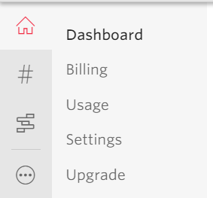
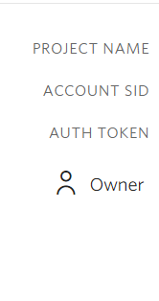

Twilio – Set up an account
<Your email address>
<Account ID>
Your Account ID needs to be compiled into the Redirector code.
The Auth token here needs to be entered onto the Geo SCADA ‘Notify Redirector’ object properties.

Slide 10
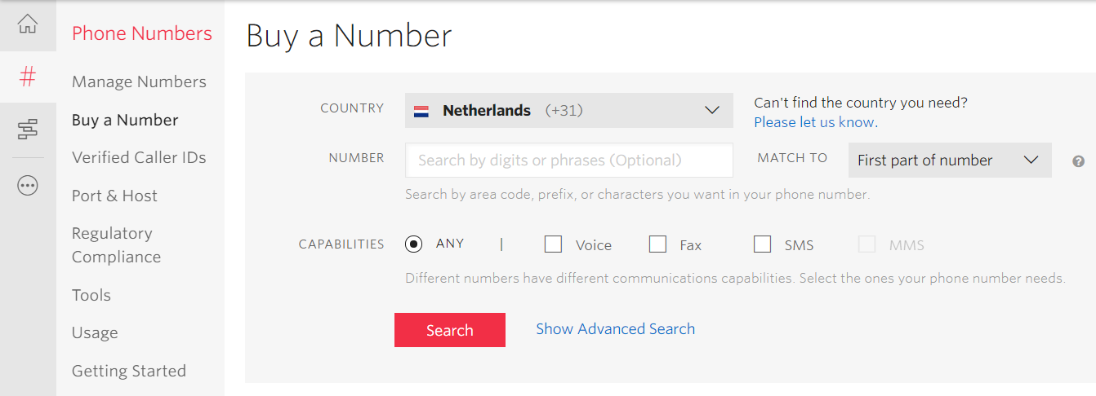
Twilio – Buy a Number – for the outgoing calls
Select your country and click ‘Search’. Add further search parameters if you are looking for a particular number sequence or letter codes (e.g. 1-123-SCADA !)

Slide 11
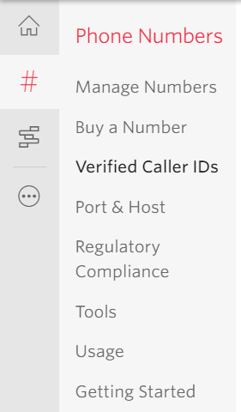
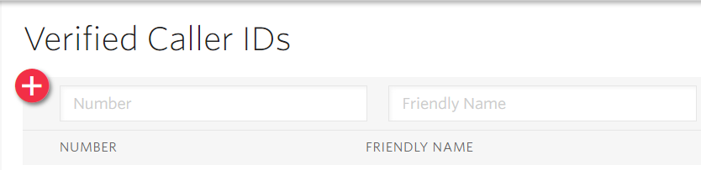
Twilio – Verified Caller IDs
Twilio, in free trial mode, will not let you send to just any number.
You need to add numbers here in order to be able to test this system.

Slide 12
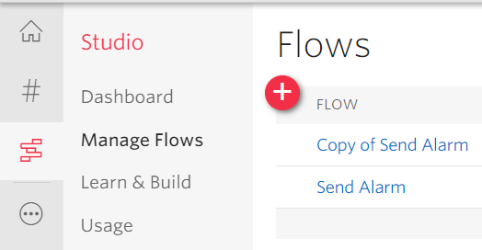
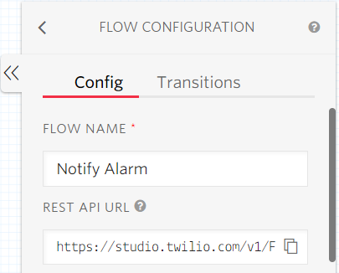
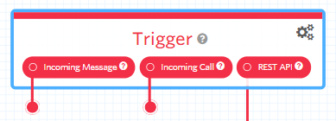
Twilio – Creating a Flow
A full flow has been produced for this. See the JSON representation of the flow within the repo – file ‘DemoTwilioFlowV1.json’ You can paste this into Twilio.
Trigger properties
Click to design a flow
Name your flow
Flows start with a trigger, our trigger is the REST API
Copy and paste this URL (ending
…/Executions) into the code of the Redirector.

Slide 13
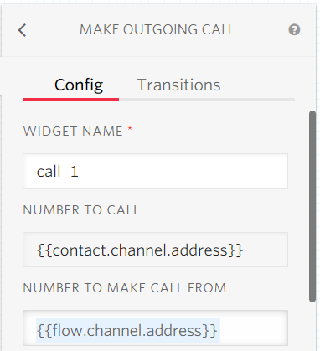
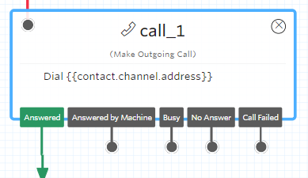
Twilio – Add a call
Connect up to API call
Set properties

Slide 14
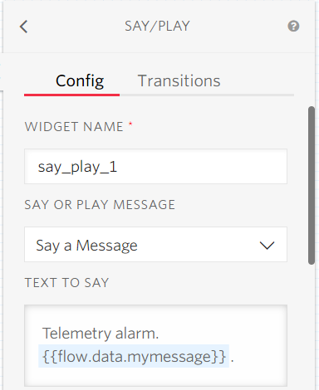
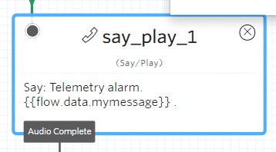
Twilio – Add ‘Say’
Text to say has your choice of introductory text followed by the message parameter:
Telemetry alarm. {{flow.data.mymessage}} .

Slide 15
Twilio – reporting back status
Add external REST calls back to the Redirector
Use parameters referenced in the function ProcessResponse in DriverNotify.cs
E.g. These can cause events such as noting that a call was not answered
Or they can cause an alarm to be acknowledged via a user’s ID and PIN

Slide 16
Twilio Full Flow Details
See the JSON representation of the flow within the repo – file ‘DemoTwilioFlowV1.json’
You can use this to work out what widgets and flow configuration are needed, or import directly
To import, create a new flow, add a name then scroll to the end of the list to see ‘Import JSON’
Flow has been edited, and items within << >> need to be adjusted for your environment, e.g. your web service endpoint URL

Slide 17


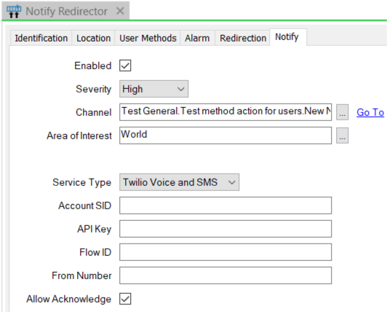
Twilio – Save and Publish
Click to save any flows:
Click to publish and make ‘live’:
On the Studio Dashboard copy the ‘SID’ (a long string) into the database object of the Redirector
Also your Account SID and Outgoing number (formatted as E.164 phone number format, e.g. +1xxxxxxxxxx) and Flow ID

Slide 18
Making it Work
Modify and build the driver
Build and copy the driver .exe and .dll to the Geo SCADA server
import the registry file from the code sample to make Geo SCADA run the driver.
Modify and build the redirector
Build the installer for the redirector, copy the .msi to the target and run it
Set up/change .config for https, port numbers, firewall restrictions etc.
Arrange for the Twilio account to be set up.
Configure the Geo SCADA Alarm Redirection parameters:

Slide 19
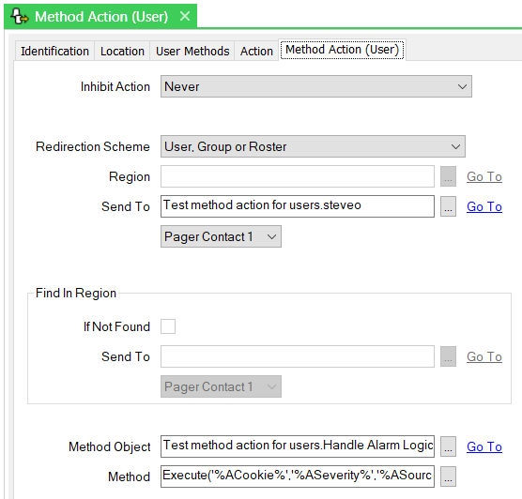
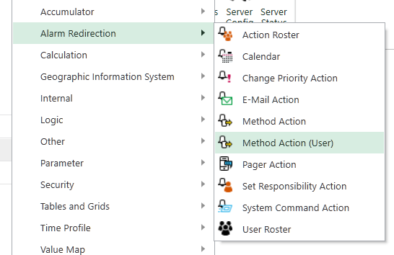
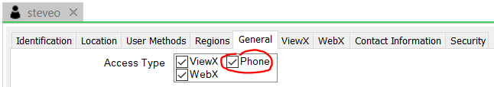
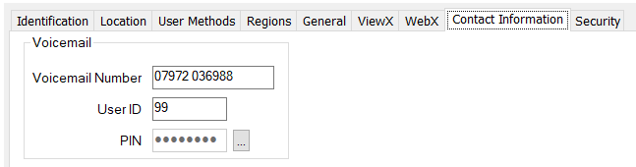
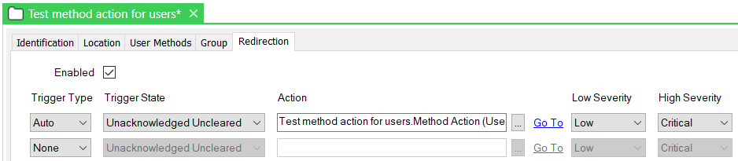
Configure Redirection
Create one of the new Method Actions for users
The new object is found in the Create New … Alarm Redirection context menu:
Add here a link to the Notify Redirector object.
create a user to target the redirection
Add method name and parameters here.
(See next page)
Add this new alarm redirection to the group/folder containing alarms to be redirected.
The phone number must be formatted as E.164 (e.g. +1xxxxxxxxxx)

Slide 20
Sample alarm text
This contains many possible fields. You may wish to omit many of them.
For NotifyMessageVoice, omit the last ‘cookie’ parameter.
NotifyAlarmVoice( 'Severity %ASeverity%. Source %ASource%. Message %AMessage%. Category %ACategory%. Condition %ACondName%. Sub-condition %ASubCondName%. Active time %ASubCondActiveDateTime%. From server %N To user %rUserId.Name%.', '%rUserId.ContactConfig.VoicemailNumber%', 'VOICE', '%ACookie%' )

Slide 21
Thank-you
Please go to the Telemetry Forum to discuss this example
https://community.exchange.se.com/t5/Geo-SCADA-Expert-Forum/bd-p/ecostruxure-geo-scada-expert-forum

